Slide 1
CHALLENGE:ARTIFICIAL INTELLEGENCE SYSTEM TO AUTOMATE PROCESS-BASED GEOLOGIC MODELS
EXPEC Advanced Research Center, Geology Technology Division
Aramco Upstream Solution Technathon October 26-28, 2018

Slide 2
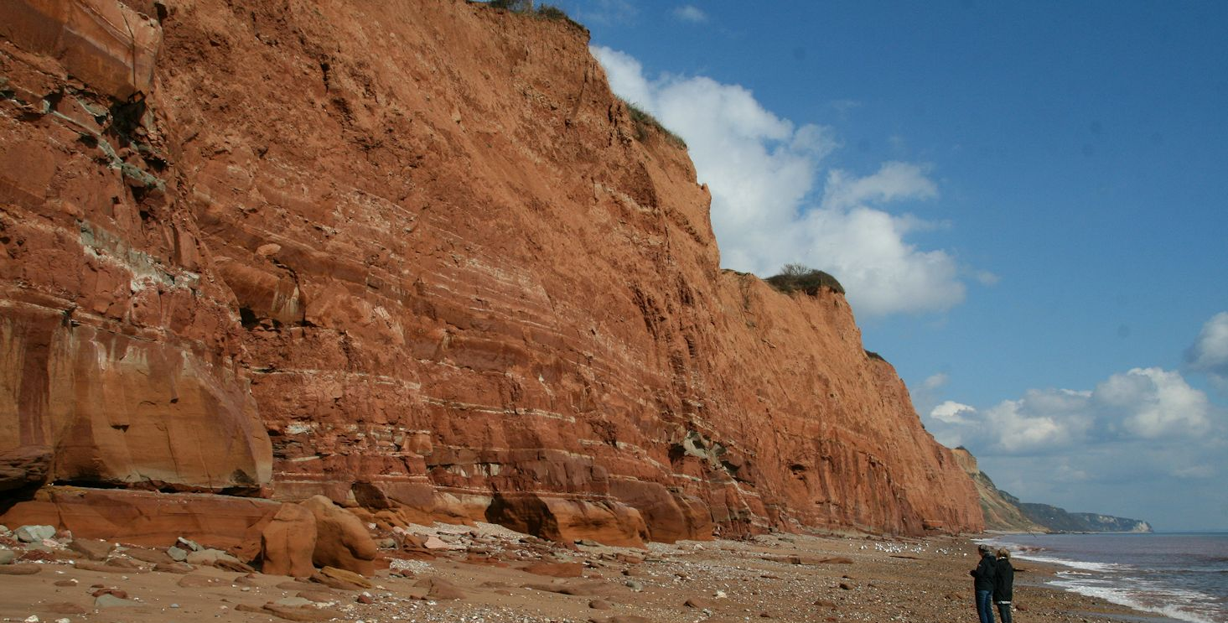
Hydrocarbon in the Subsurface
Accumulations of hydrocarbon are found in layers of porous rocks known as reservoirs.

Slide 3
Characterizing Hydrocarbon Reservoirs
Successful production of hydrocarbons requires characterizing the reservoirs.
Reservoir Characterization
Architecture
Quality
Rock types & their spatial extent
Pore volume & pore connectivity (permeability)

Slide 4
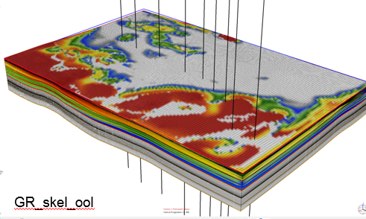
Process-Based Geologic Models
Solving the physics of geologic processes in the subsurface.
Numerical representations of rock types or corresponding physical properties.
Vertical and horizontal directions (2D/3D).
Computational way to characterize and visualize hydrocarbon reservoirs.

Slide 5
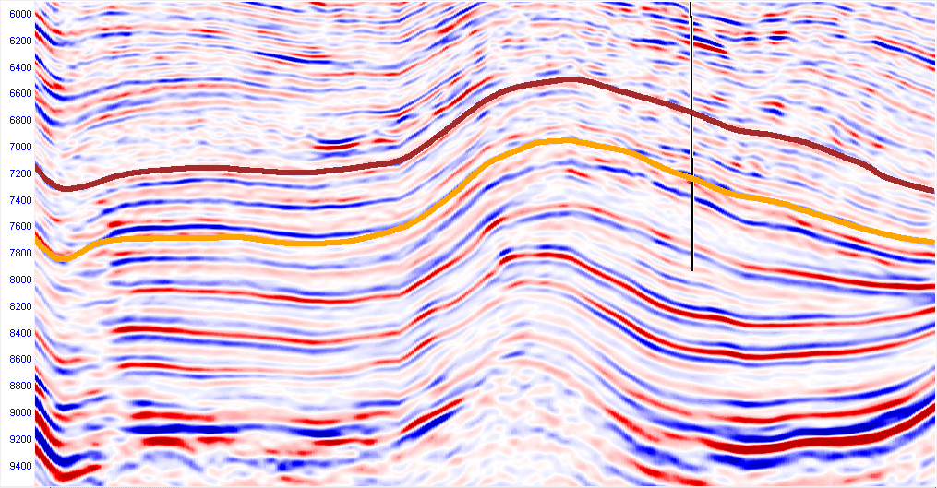
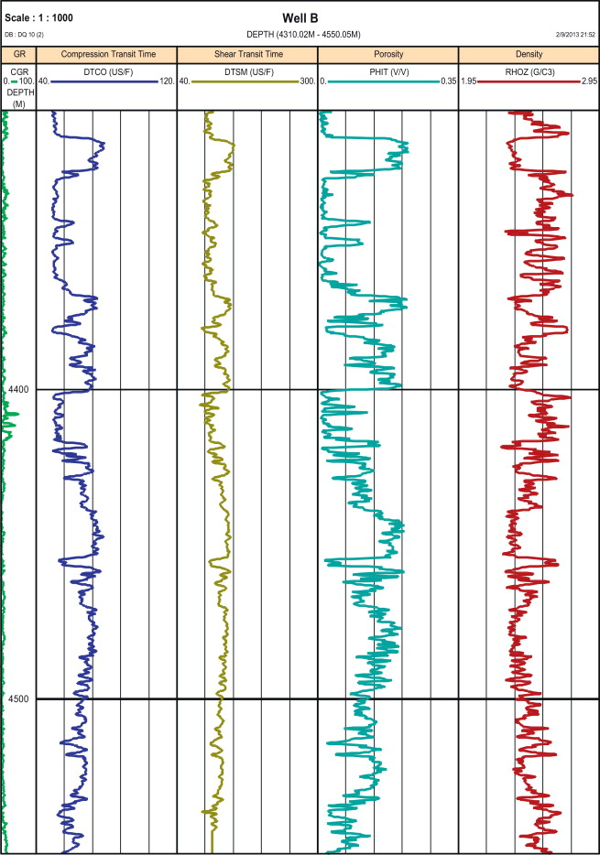
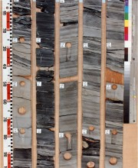
Constructing Process-Based Geologic Models
Integrate data of different resolution to define:
Maps of the layers
Rock types + physical properties
seismic data
coarse vertical resolution
well log and core data
coarse vertical resolution

Slide 6
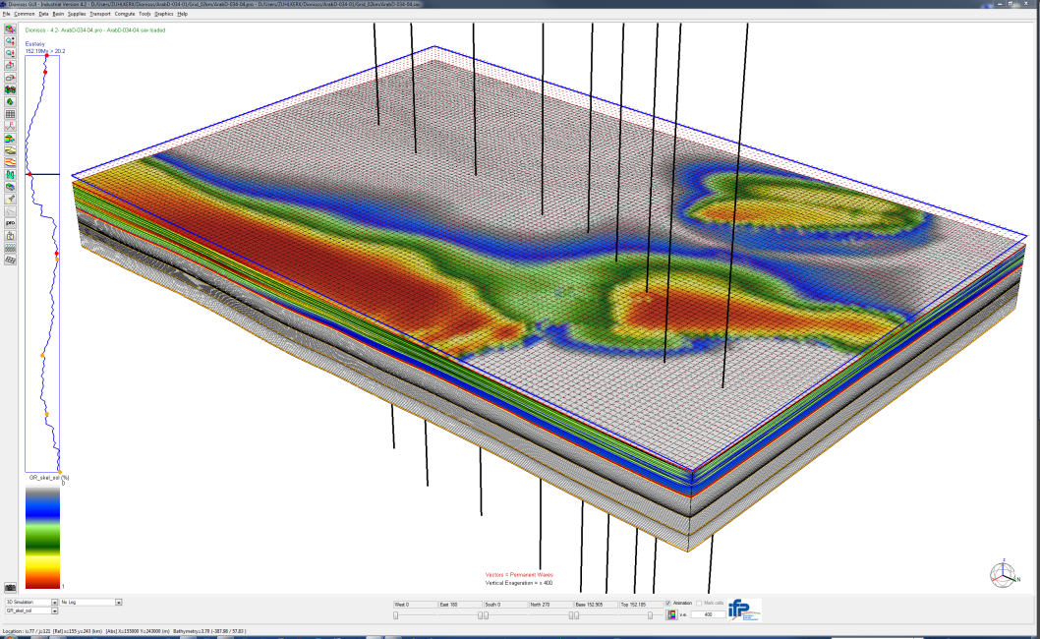
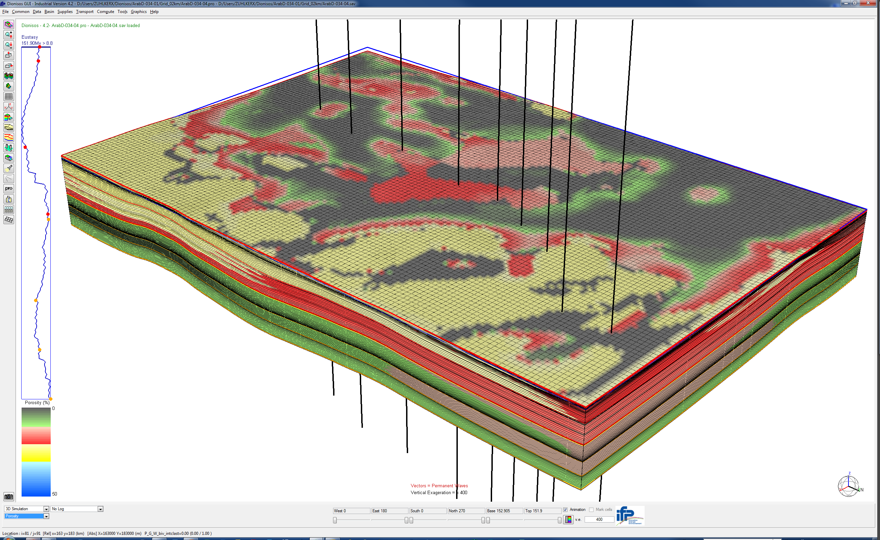
Constructing Process-Based Geologic Models
Simulating the physics based on the inputs to output:
Model of rock types
Model of porosity
Rock Type
Porosity
A
Low
B
C
D
High

Slide 7
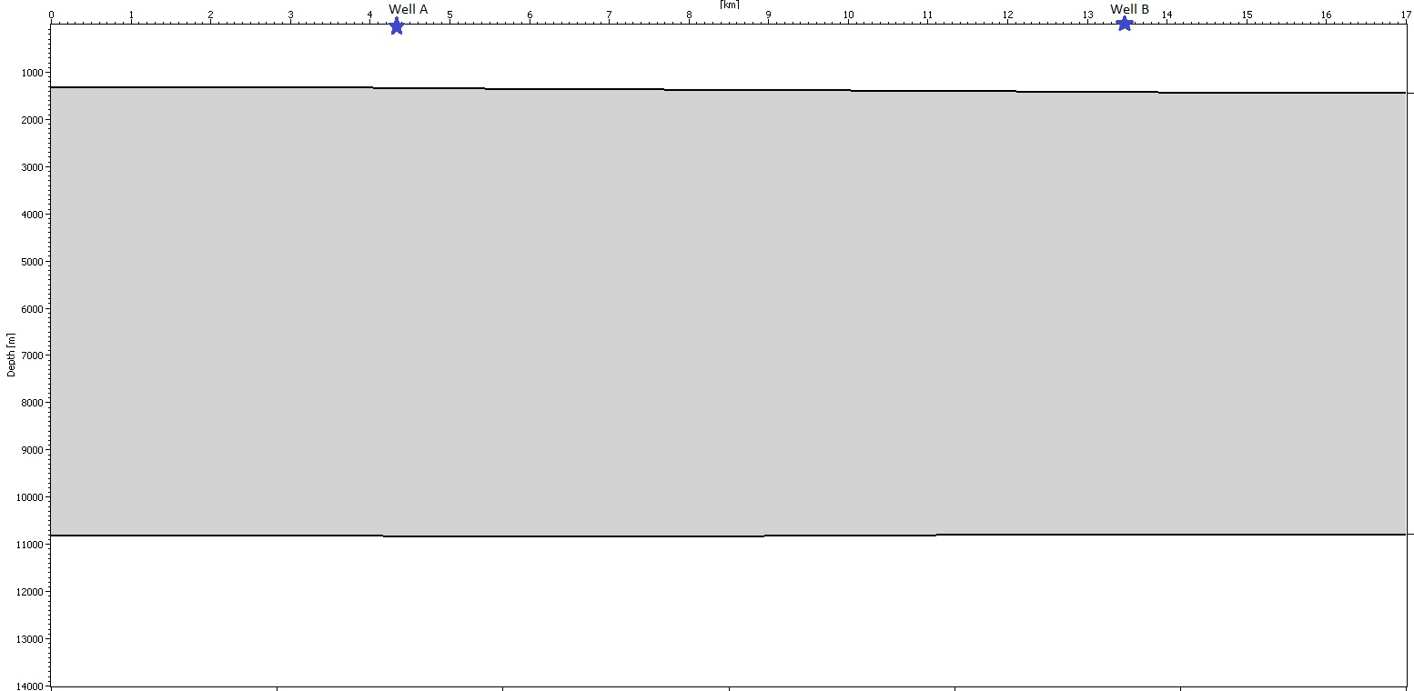
Challenge: Automated Geologic Model
Design an artificial intelligence system (code) that:
Automates the integration of seismic, well log and core data.
Populate 2D models of the reservoir rock types and porosity (grid resolution =2.5 m).

Slide 8
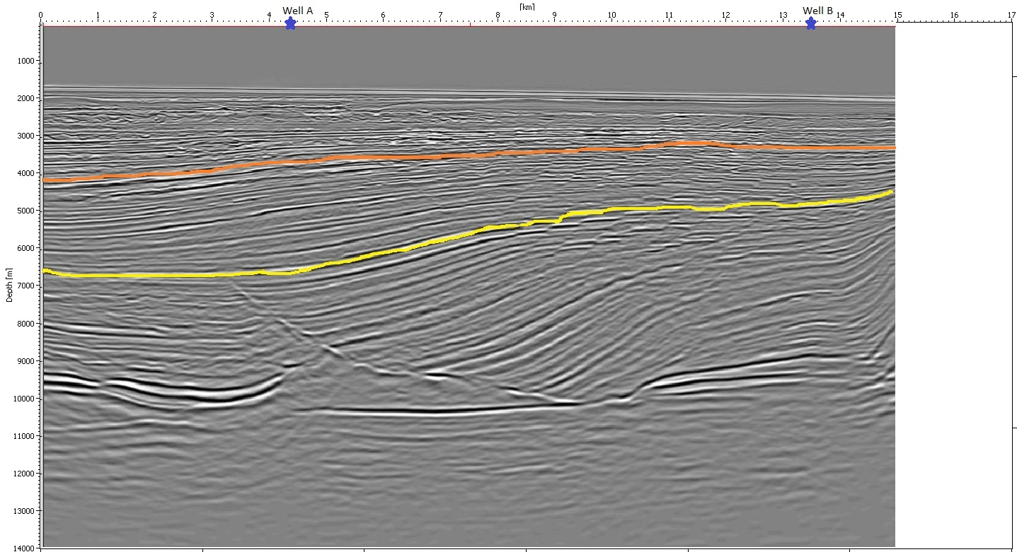
Challenge: Integrating Seismic Data
Use the 2D seismic line (vertical resolution = 25 m) to:
Define the top and bottom of the reservoir and the model.
Identify the general spatial trends of the sublayers in the reservoir.

Slide 9
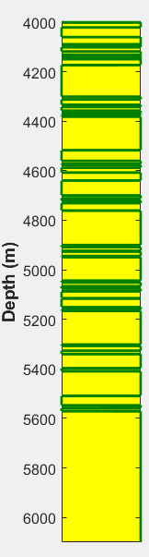
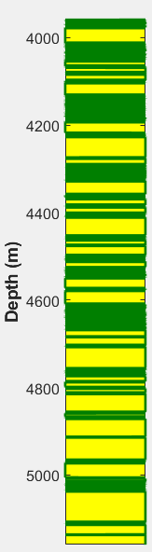
Challenge: Integrating Core Data
Use the core data (vertical resolution~ 5 cm) to generate a model of rock types :
Upscale the variations of rock types at well locations.
Populate the model by honoring the core data and the spatial trend reservoir.
sandstone
shale

Slide 10
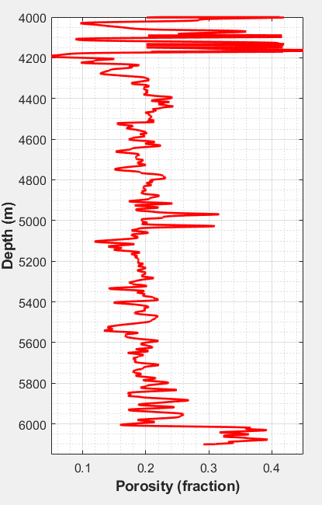
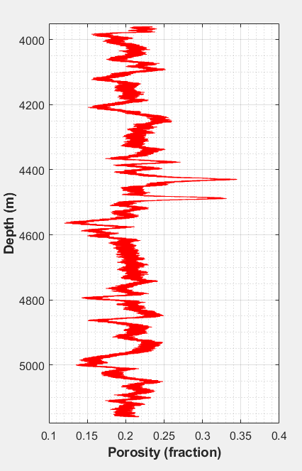
Challenge: Integrating Well Log Data
Use the core data (vertical resolution~ 5 cm) to generate a model of rock types :
Upscale the variations of porosity at well locations.
Populate the model by honoring the well data and the rock types model.

Slide 11
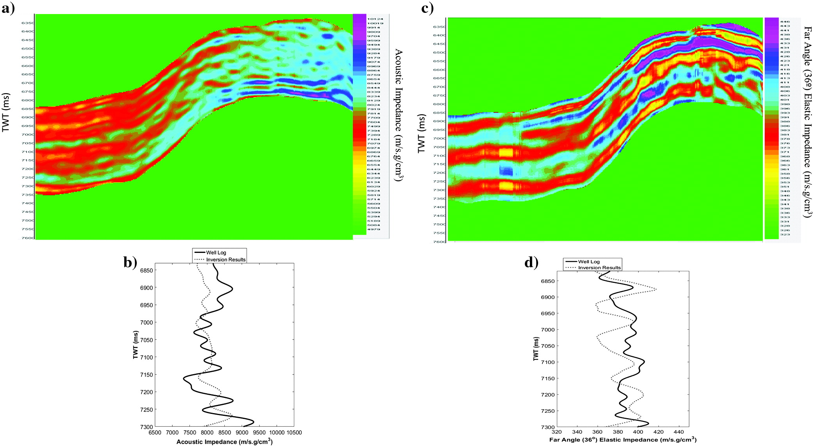
Challenge: Deliverables
Running code to integrate the provided data of different resolution.
2D models of rock types and porosity such that:
Model resolution = 2.5 m.
Honoring the discussed method for populating the model.
Judging is based on the efficiency of the code and the plausibility of the outputs.
Rock Types
Porosity

Slide 12

For any questions:
Wisam.kawai@Aramco.com
Lama.abualsaud@Aramco.com

